Slide 1


Preview to MAUI
(Multi-platform App UI)
Week 2
© COGNIZANT SOFTVISION 2021

Slide 2
https://github.com/Magenic/MAUIPreview

Slide 3
Demo 1 – Intro to Xamarin Forms Week 2 Demo

Slide 4
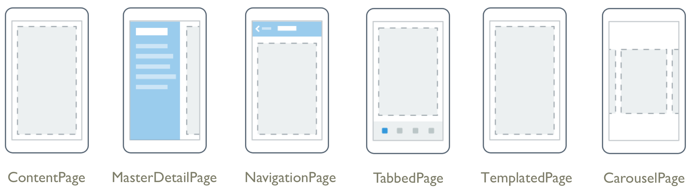
UI Concepts
Page
View
Layout
Cell
FlyoutPage

Slide 5
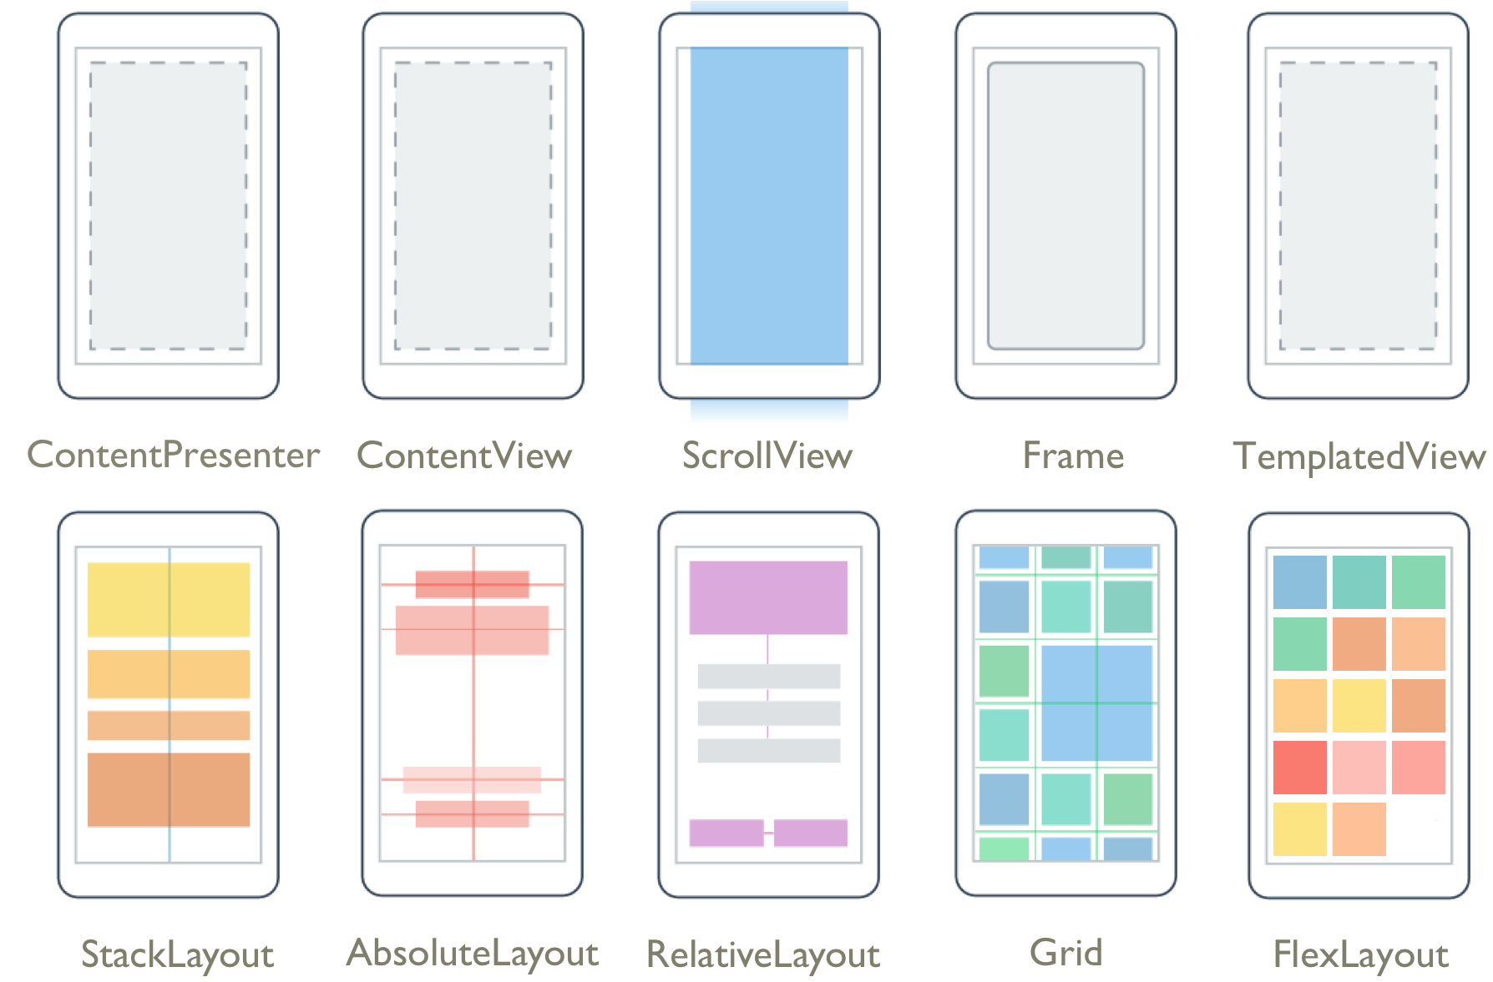
Xamarin Forms Layouts

Slide 6
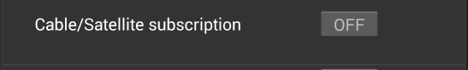
StackLayout
<StackLayout Orientation="Vertical" Spacing="20" Padding="0, 0, 0, 0">
<StackLayout Style="{StaticResource
IndividualEntryRegionStyle}">
<controls:ExtendedLabel Text="{Binding
OptionText}”
HorizontalOptions="StartAndExpand"
Style="{StaticResource LabelStyle}" />
<Switch IsToggled="{Binding IsOptionSelected,
Mode=TwoWay}" HorizontalOptions=”Fill" />
</StackLayout>
<BoxView HorizontalOptions="FillAndExpand"
Style="{StaticResource LineStyle}"></BoxView>
</StackLayout>
Start and Expand
Fill
Padding = 20
Stack Layout
Padding = 20
Spacing = 20
BoxView

Slide 7

Sizing Views
Sizing is a collaboration
View want’s width to be same as parent and height to be same a width
Layout queries view for requested size
Layout returns the size allocated
Units determined by platform
Layout returns space it is allocating: for example: 360 x 360
iOS: Points
UWP: Effective Pixels
Android: Density Independent Pixels (dp or dip)

Slide 8
View Layout Preferences
Four preference Types
HeightRequest
WidthRequest
VerticalOptions
HorizontalOptions
VerticalOptions/HorizontalOptions default to fill

Slide 9
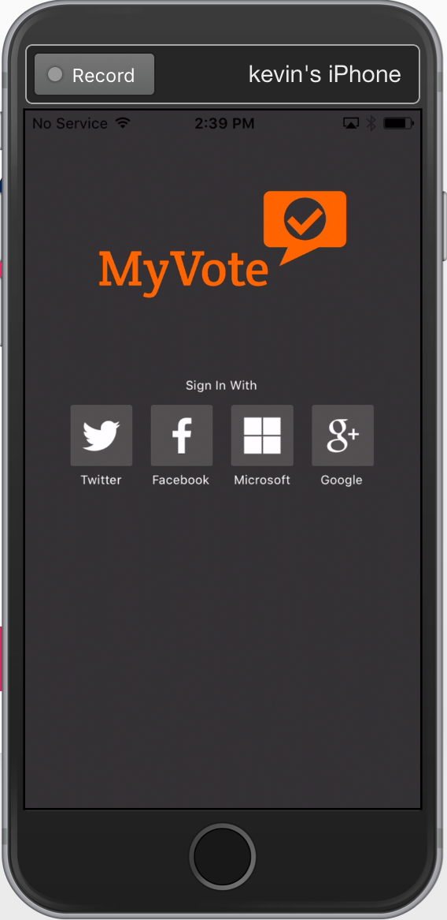
Vertical/Horizontal Options
View Layout Options
Start
StartAndExpand
End
EndAndExpand
Center
CenterAndExpand
Fill
FillAndExpand
“AndExpand” options only used on StackLayouts

Slide 10
StackLayout and ‘AndExpand’
‘AndExpand’ Options take all available space
If multiple ‘AndExpand’ views, remaining space shared equally
Expansion only in direction of orientation
View only takes up unexpanded size
LeftPadding = 20
Start and Expand
Fill

Slide 11
LayoutOptions Need to Know
Non ‘AndExpand’ options ignored when with StackLayout orientation - Fill
Start
End
Center
Fill
‘AndExpand’ ignored when opposite StackLayout orientation
StartAndExpand = Start
EndAndExpand = End
CenterAndExpand = Center
FillAndExpand = Fill

Slide 12
Demo 2 – Stack Layout

Slide 13
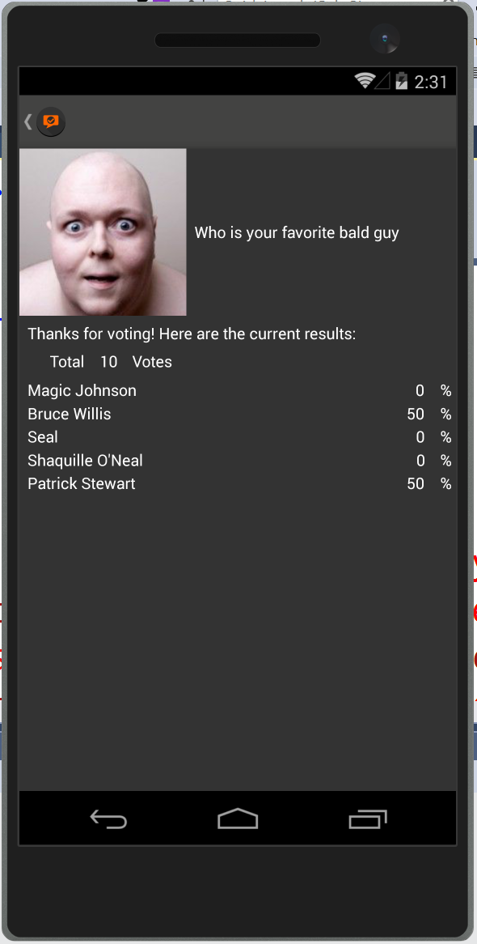
Grid Layout
<Grid.RowDefinitions>
<RowDefinition Height="Auto" />
<RowDefinition Height="Auto" />
<RowDefinition Height="Auto" />
<RowDefinition Height="Auto" />
<RowDefinition Height="*" />
</Grid.RowDefinitions>
</Grid.ColumnDefinitions> <ColumnDefinition Width="Auto" />
<ColumnDefinition Width="*" />
</Grid.ColumnDefinitions>
<Image Grid.Column="0” Grid.Row="0"
VerticalOptions="LayoutOptions.Start"
WidthRequest="150" HeightRequest="150"
Aspect="AspectFill”
Source="{Binding PollResults.PollImageLink}" />
Row = 0
ColumnSpan=2
Row = 1
Row = 2
Row = 3
Row = 4
Column = 0
Column = 1

Slide 14
Demo 3 – Grid Layout

Slide 15
Relative Layout
<RelativeLayout HorizontalOptions="FillAndExpand” VerticalOptions="FillAndExpand">
<Image x:Name="curImage" Aspect="AspectFill"
VerticalOptions="FillAndExpand" Source="{Binding ImageLink}"
RelativeLayout.XConstraint="{ConstraintExpression Type=RelativeToParent, Property=Width, Factor=0, Constant=0}"
RelativeLayout.YConstraint= "{ConstraintExpression Type=RelativeToParent, Property=Height, Factor=0, Constant=0}"
RelativeLayout.WidthConstraint= "{ConstraintExpression Type=RelativeToParent, Property=Width, Factor=1, Constant=0}"
RelativeLayout.HeightConstraint= "{ConstraintExpression Type=RelativeToParent, Property=Width, Factor=1, Constant=0}">
</Image>
<controls:ExtendedLabel Text="{Binding Question}" HeightRequest="75" LineBreakMode="WordWrap" TextColor="White" Font="Bold“
BackgroundColor="#98434342"
RelativeLayout.WidthConstraint= "{ConstraintExpression Type=RelativeToParent, Property=Width, Factor=1, Constant=0}"
RelativeLayout.XConstraint= "{ConstraintExpression Type=RelativeToParent, Property=Width, Factor=0, Constant=0}"
RelativeLayout.YConstraint= "{ConstraintExpression Type=RelativeToView, ElementName=curImage, Property=Height, Factor=1, Constant=-75}" />
</RelativeLayout>
X = Parent width * 0 = 0
Y = Image Height * 1 - 75 = (Image Height – 75)
Y = Parent height * 0 = 0
Height = Parent height * 1 = Parent height
Height = 75
Width = Parent width * 1 = Parent width
Width = Parent width * 1 = Parent width

Slide 16
Demo 4 – Relative Layout

Slide 17
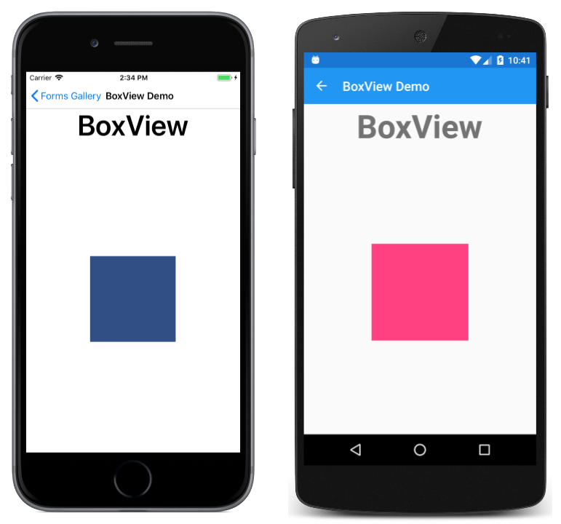
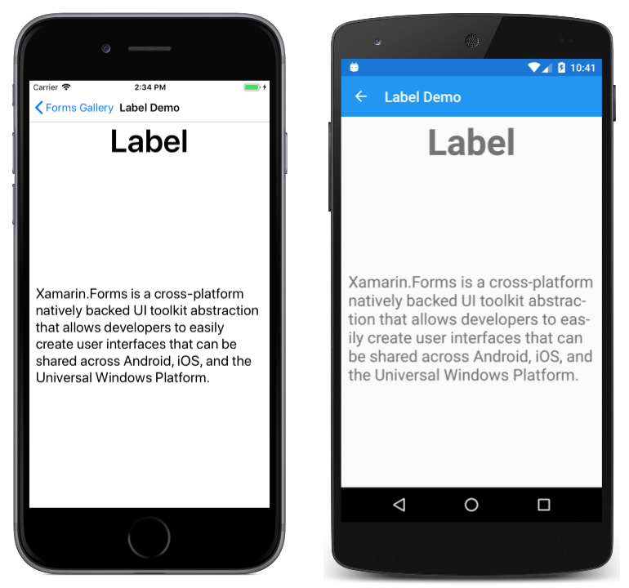
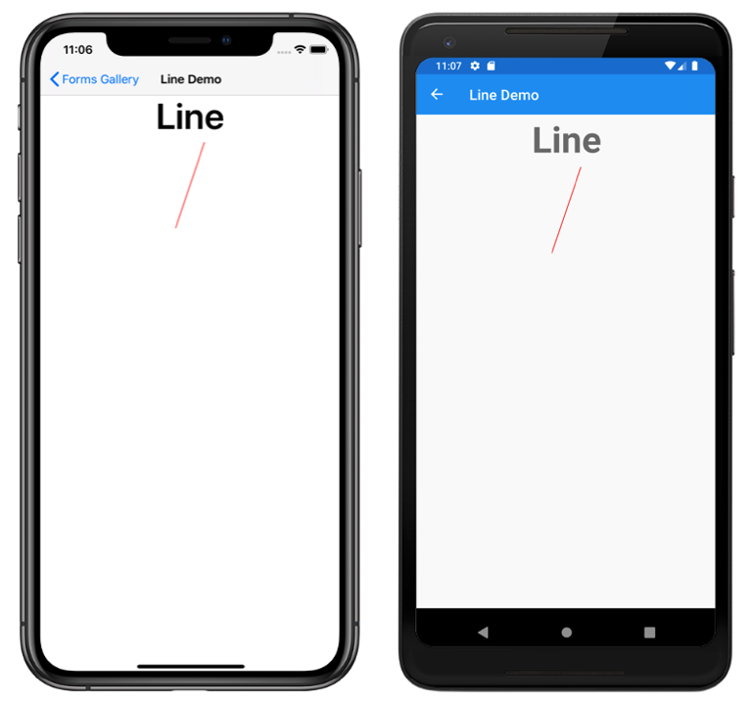
Views

Slide 18
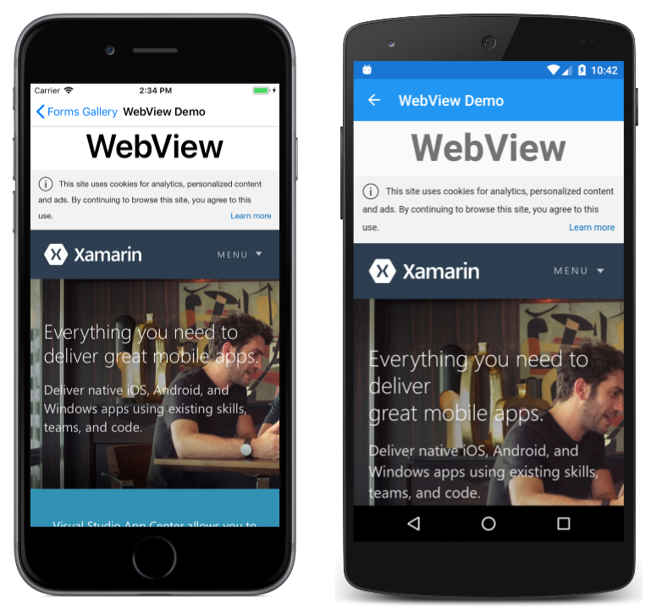
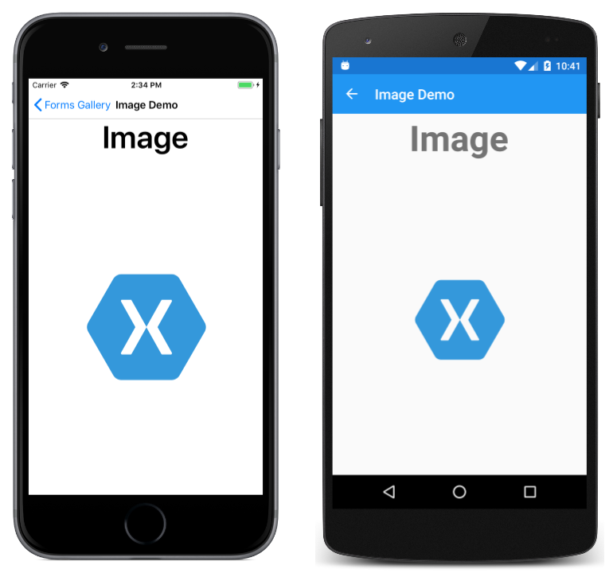
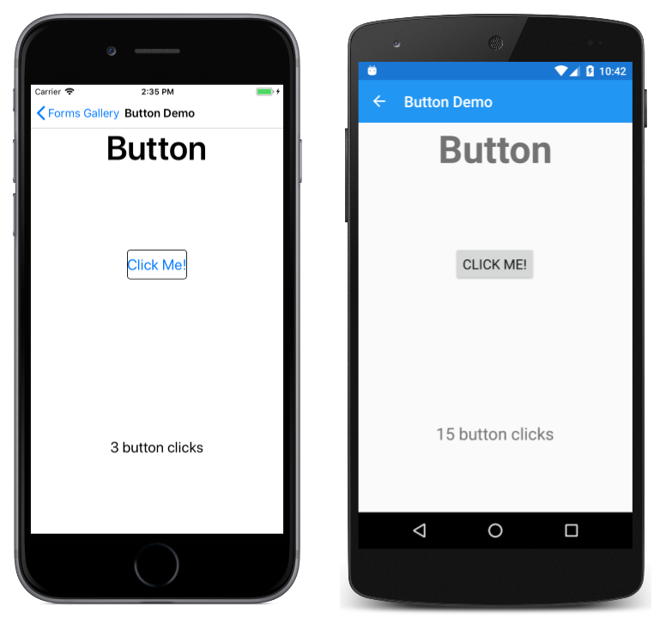
Views

Slide 19
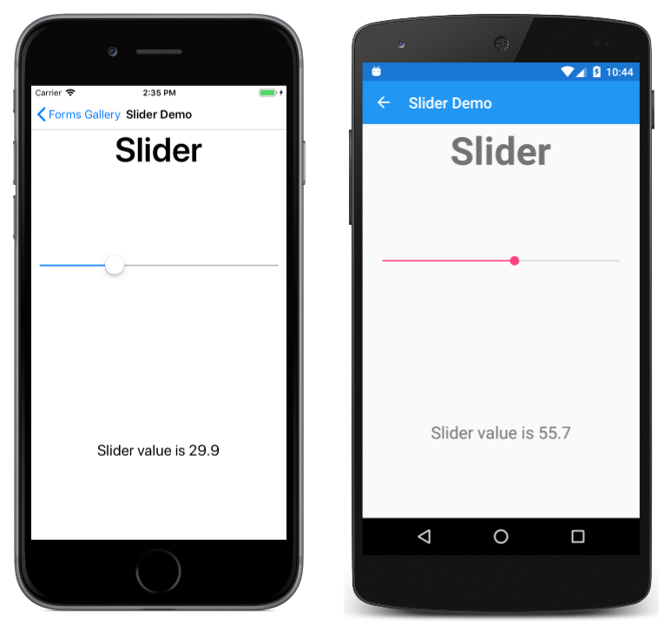
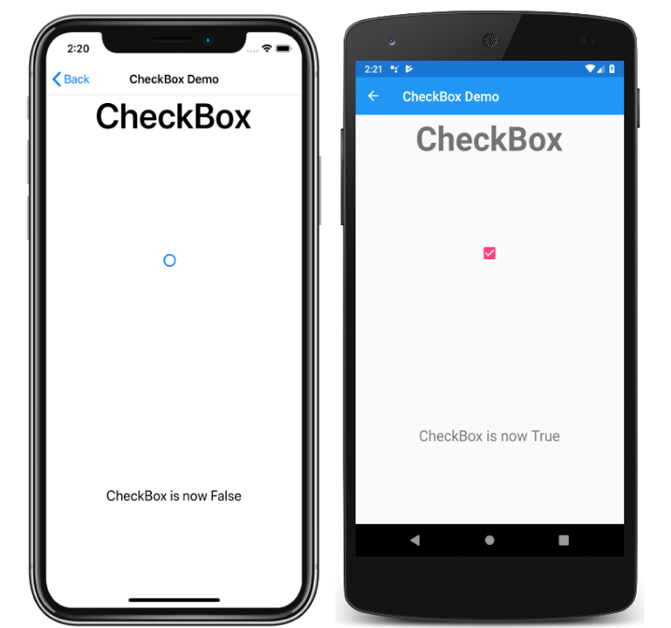

Views

Slide 20

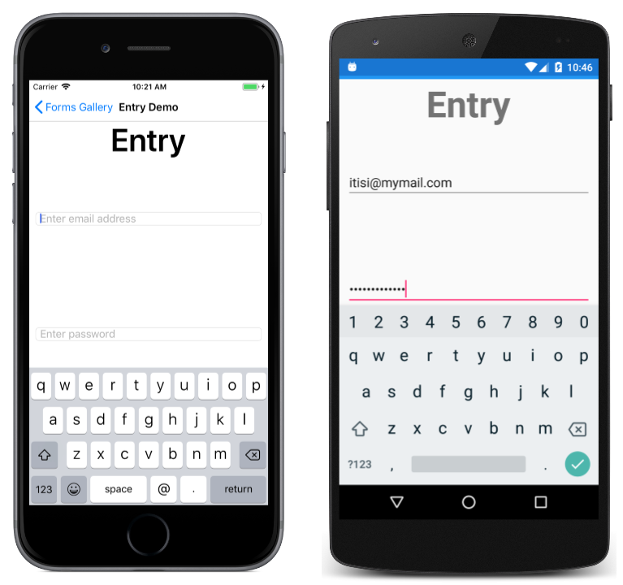
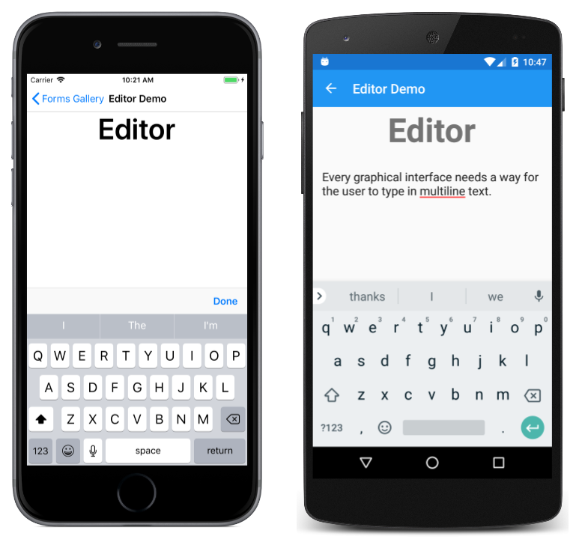
Views

Slide 21
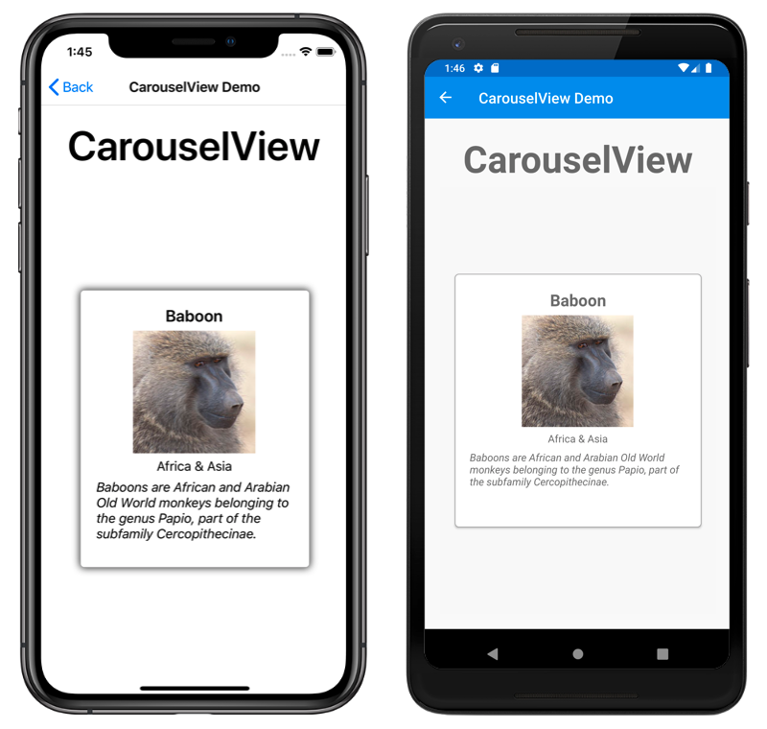
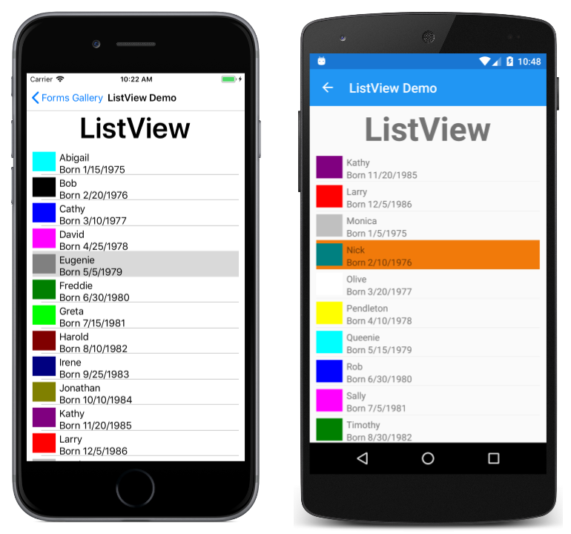
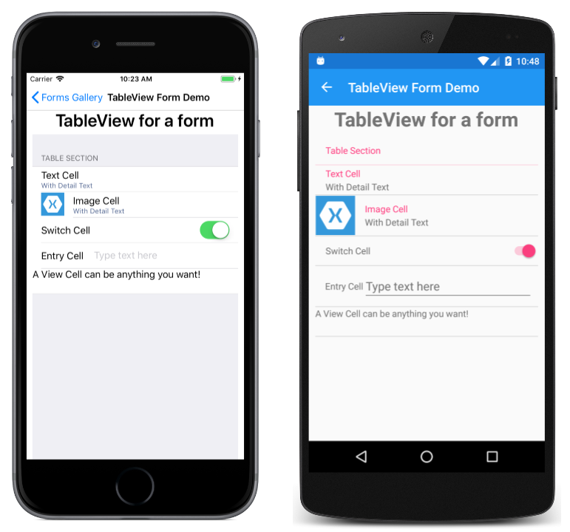
Views

Slide 22
And the list keeps coming
https://docs.microsoft.com/en-us/xamarin/xamarin-forms/user-interface/controls/views

Slide 23
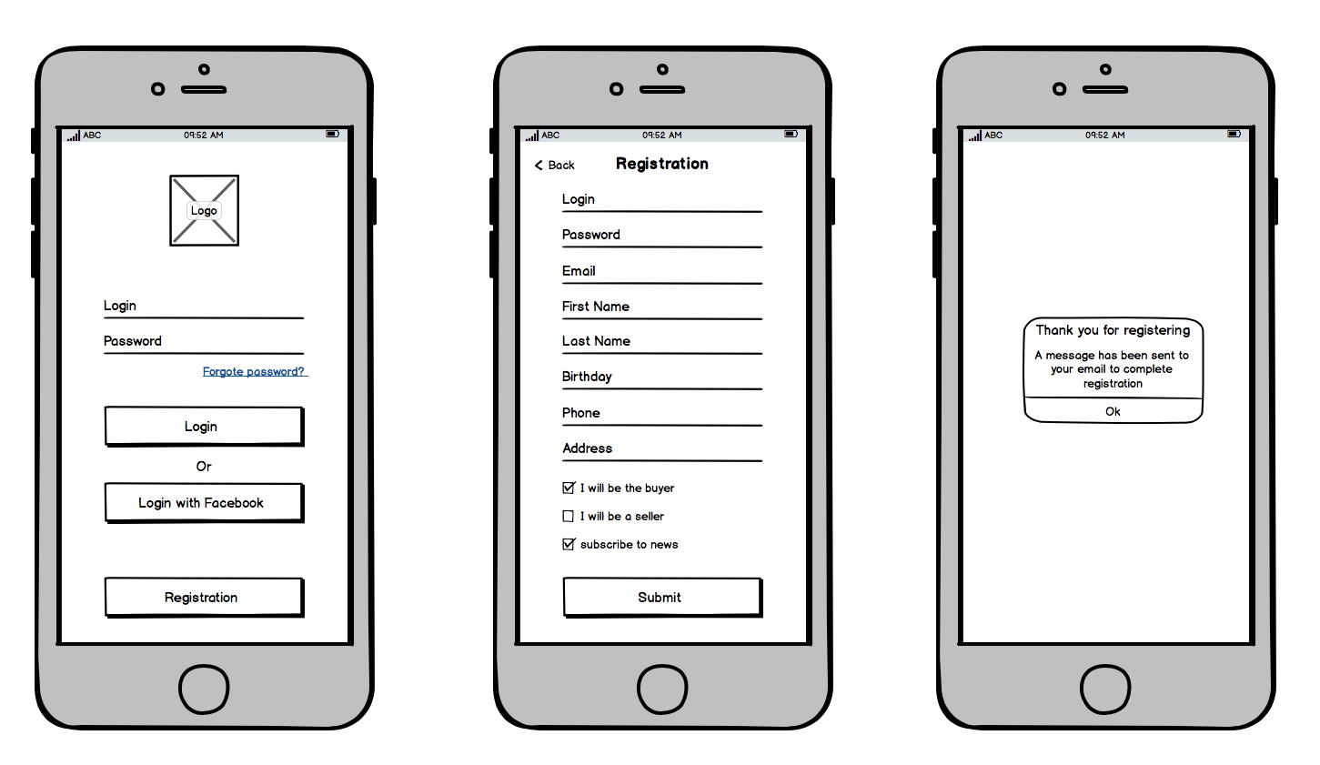
Getting a layout from a designer

Slide 24
Questions

